Slide 1
Quiz 10/04/14
1. Recently, it has been possible to increase the accuracy of locating a single fluorophore (see diagram). What factors are critical to how well you can localize it? What is the general equation?
Accuracy = width/sqrt N, N= # photons collected. Width = λ/2NA: λ= wavelength of excitation.
2. Discuss STORM/PALM. What does it do? How does it do this? [STORM and PALM are two names for the same technique.]
You can get nanometer resolution. Have all molecules off, then sparsely activate a few of them (< 1 / diffraction-limited spot). Excite them to make them fluoresce; localize with FIONA (answer to #1), getting nanometer accuracy); repeat.

Slide 2
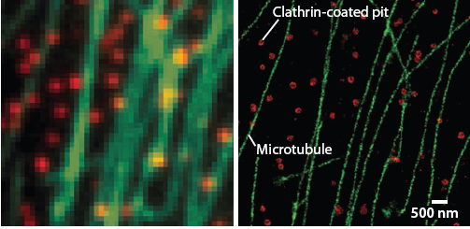
On class of Super-Resolution Microscopy Inherently a single-molecule technique that relies on blinking or on/off behavior
Huang, Annu. Rev. Biochem, 2009
STORM
STochastic Optical Reconstruction Microscopy
PALM
PhotoActivation Localization Microscopy (Photoactivatable GFP)
Bates*, 2007 Science
(Won 2014 Nobel Prize)

Slide 3
More STORM Images
Dani, Zhuang, 2010, Neuron

Slide 4
STimulated Emission Depletion (STED)
Recent development in super-resolution microscopy
S. Hell
(2014 Nobel Prize)
Net result is a smaller (than λ/2NA) Point Spread Function
Sharpen the fluorescence focal spot is to selectively inhibit the fluorescence at its outer part.
200nm
Huang, Annu. Rev. Biochem, 2009
http://www.mpibpc.gwdg.de/groups/hell/

Slide 5
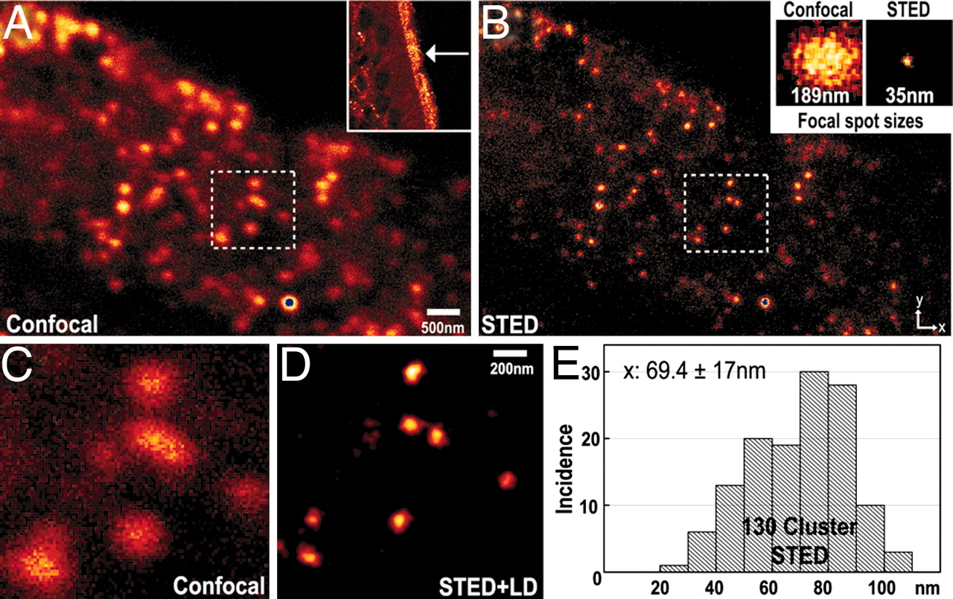
Biological Example of STED
The transient receptor potential channel M5
Analysis of spot size for Confocal (A) and STED (B) images of TRPM5 immunofluorescence layer of the olfactory epithelium. (A, C Inset) Confocal image at a lower (higher; box) magnification taken with a confocal microscope. (B) STED image. Effective point-spread function in the confocal (189 nm) and STED (35 nm) imaging modes.
Hell, PNAS, 2007

Slide 6
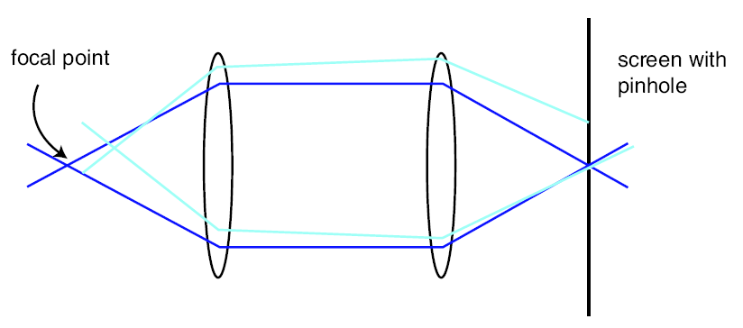
Sample is 3-D. Detectors are 2-D. How do you get z-axis sectioning with Microscopy? A pinhole allows only in-focus light through
(Regular microscopy) Confocal Detection
3-D sample
Detector
(Intensity)
Focused Light creates fluorescence which
gets to detector
Light mostly
gets rejected
Smaller the pinhole, better out-of-focus discrimination but lose more signal.
Scan sample in x, y, z and reconstruct entire image

Slide 7
3-D sectioning with Confocal
Three-dimensional reconstruction of a series of 2D images of PMMA spheres

Slide 8
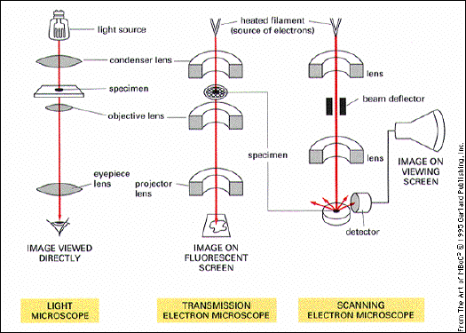
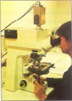
Microscopes
Cells discovered with invention of microscope.
MBC, Fig. 4-
Or with CCD
1000x, 0.2um 10⁶x, 2 nm 20,000, 10 nm (3-d)

Slide 9
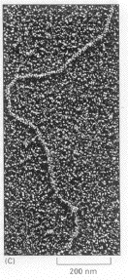
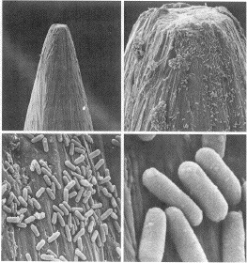
Techniques for measuring distances
(where physicists have made a big impact on bio.)
X-ray diffraction (atomic resolution)
Electron (Imaging) Microscopy (nm-scale)
Visible (Imaging) Microscopy (nm - µm)
Bacteria on head of a pin
at different magnifications

Slide 10
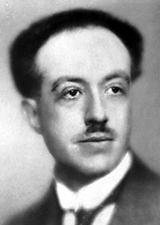
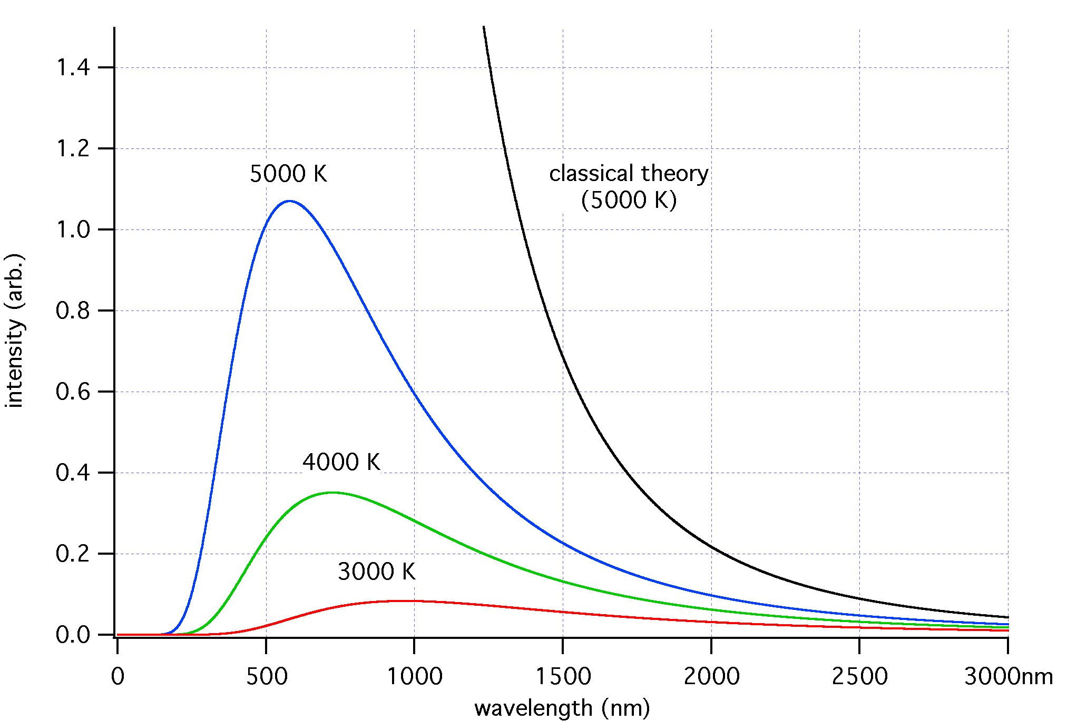
λ of electrons
(Who was famous guy who got Nobel prize in 1929 for the “wave nature of electrons”?
What relationship between wavelength, λ, and energy, E, and momentum, p, does this correspond to?
Debroglie
E= hν = hc/λ; p = h/λ
Where does Planck’s constant come from?
The Planck constant came from law of black body radiation: that the electromagnetic radiation emitted by a black body could be modeled as a set of harmonic oscillators with quantized energy of the form: E = hν
http://en.wikipedia.org/wiki/Black-body
Relationship between radiation of an object and its temperature

Slide 11
Resolution of Electron Microscope
Given electron 100 KeV,
(typical upper-value for electron microscope)
what is λ?
(h =6.63 × 10⁻³⁴ J-sec = 4.1 × 10⁻¹⁵ eV-sec)
E_{100kV} = 0.004 nm (really short!)
In reality, because not perfect electron lenses, resolution is ~1 nm.
E.M. are far from ideal.

Slide 12
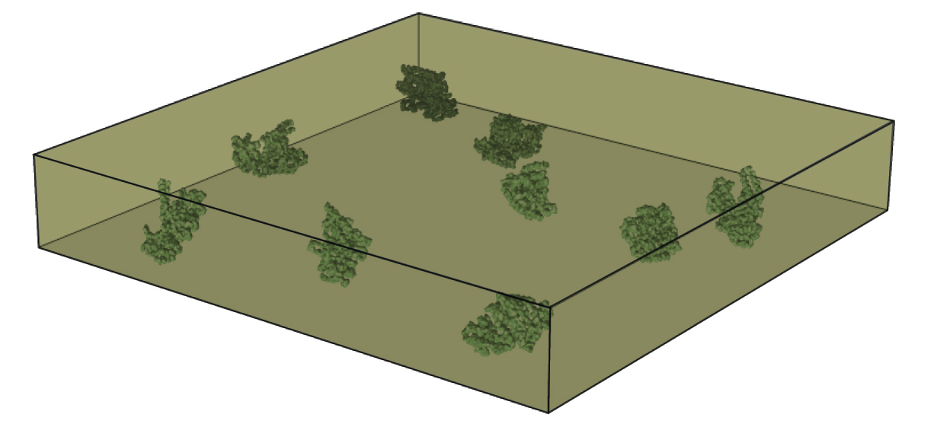
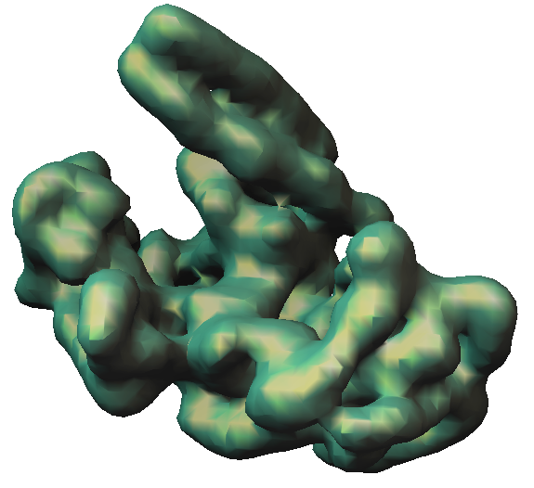
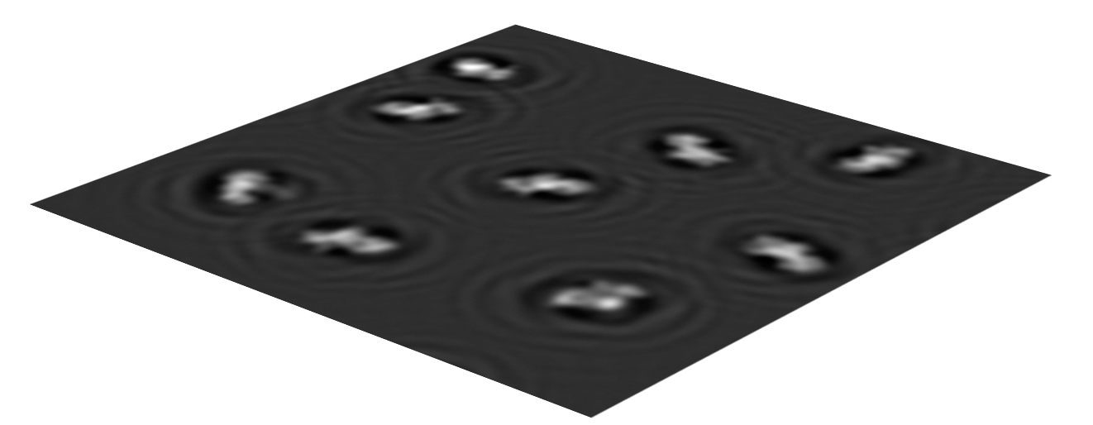
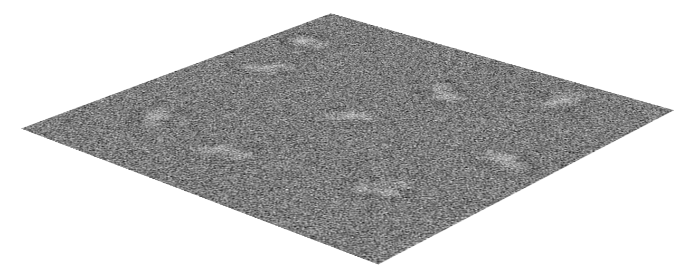
Recent Revolution: Single Particle E.M.
When combined with x-ray crystallography, the most amazing technique!
Atomic resolution on samples which you can’t crystallize the whole thing!
3D RECONSTRUCTION
EM IMAGING
Class
Average X
Class
Average Y
Class
Average Z
AVERAGING
NOISE
Class X
Class Y
Class Z
CLASSIFICATION
ALIGNMENT
Andres Leschziner
Notes:
Let me summarize what the analysis of Single Particle Reconstruction involves.

Slide 13
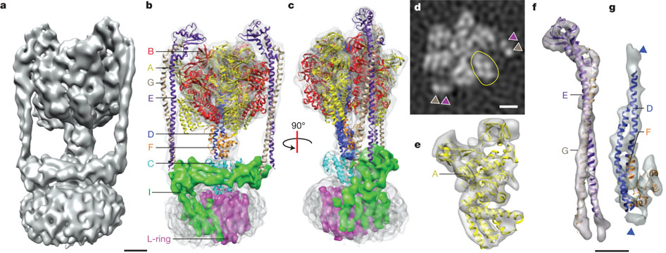
Three-dimensional map of the T. thermophilus ATP synthase
WCY Lau & JL Rubinstein Nature (2011)

Slide 14
Class evaluation
What was the most interesting thing you learned in class today?
2. What are you confused about?
3. Related to today’s subject, what would you like to know more about?
4. Any helpful comments.
Answer, and turn in at the end of class.

